Slide 1


BEING PREPARED FOR A NATURAL DISASTER
ARE YOU READY?
Notes:
Aloha!
My name is _____________________.
Today, I will be speaking about Natural Disaster Preparedness.
How many of you feel prepared as of today? Let them raise their hands.
(if there are some, that ‘s good)
For those who did not raise your hands, that’s okay. This briefing is to assist to get prepared. Thank you for being honest.
This is a leadership priority.
Keep in mind, The Hawaii National Guard is the first to be called when there’s a natural disaster in the State of Hawaii.
Let’s get ready and be prepared!
Please listen, take notes and ask question if needed.
Next slide…..

Slide 2
WELCOME
Objectives
  Orientation to Emergency Preparedness & Operation Prepare
  Provide you with information and resources to better serve your family and community
REMEMBER
  Be Informed
  Have a Plan
  Make a Kit
Notes:
WELCOME
The Objectives are:
Orientation to Emergency Preparedness & Operation Prepare
Provide you with information and resources to better serve your family and community
Here’s what we want you to REMEMBER:
Be Informed
Have a Plan
Make a Kit

Slide 3
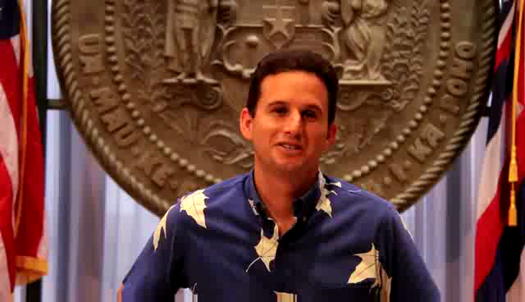
Lt. GOVERNOR OF THE STATE OF HAWAII
BRIAN SCHATZ
Natural Disaster Preparedness
Notes:
Please watch AND LISTEN TO this MESSAGE by our LT GOVERNOR OF THE STATE OF HAWAII BRIAN SCHATZ

Slide 4
Natural Disaster Preparedness
Notes:
Can you names some of the natural disasters that occur?
Can any one name some the disasters have occurred in out State of Hawaii?
If someone says one, response, Thank you for sharing.
NOTES: Let them name some of the disasters that have occurred.
If no one says anything that’s okay.
Just say: ‘Today, we will learn about some disasters that happen in our state .
ASK: How important is it to get prepared for a Natural Disaster?
Next Slide….

Slide 5
When your state calls , will your family be ready with you? Or without you?
Natural Disaster preparedness
Notes:
Here’s A question for you. Think about it! If the State of Hawaii calls us to duty, will you be ready? Most importantly, will your family be able to be self-sufficient for at least 7 days?
Is there enough water and food for each person?
Is there formula for kids?
Is there medication for the those who depend on it?
Honestly, can you be called to duty with a clear conscious that your family is prepared?
Is there enough food for your pets?
Think about it!
I hope after this presentation you will go home, get a plan together, make a kit suitable for your family!
Next slide…..

Slide 6
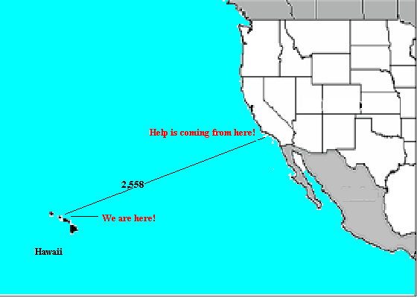
So why is preparedness so important in paradise?
We live in a geographically isolated area
We need to be self sufficient for 7 days!
95% of all food and other supplies come in via container ship
Oahu only has about 3 day food supply to restock stores!
Notes:
Why is it important that we are prepared?
We live in a geographically isolated area
We need to be self sufficient for 7 days!
95% of all food and other supplies comes in via container ship
Oahu only has about 3 day food supply to restock stores!

Slide 7




Natural Hazards CAN Happen Here
Hurricane
Tsunami
Earthquake
Power Outage
Notes:
In our area, we are most susceptible to these natural hazards.
Hurricane Season: June 1st to November 30

Slide 8





Other Natural Hazards
Volcano
Flood
Wild Fire
Tornado
Land Slide
Notes:
Here are other Natural Hazards.
Although less likely to occur, we face other possible natural hazards in this area.
We do have a Volcano on our neighbor island. The Big Island (HAWAII).
We usually get some of it’ VOG, that bothers so people’s health, right?
What is VOG?
Vog is a portmanteau of the words "volcanic" and "smog," and a volcanic smog is formed when sulfur dioxide and other gases emitted by an erupting volcano mix with oxygen and moisture in the presence of sunlight. The term is most often applied to the island of Hawaii, where the Kilauea volcano has been erupting continuously since 1983. Kilauea emits an estimated 2,000 tons of vog every day.
During periods of Kona Winds, or winds that blow from the southwest or SSW when have a low pressure within 500 miles NW of the islands
When it is “voggie” people with respiratory problems need to take precautions.

Slide 9
Hawaii’s Hazard Profile
Low Threat
High Threat
Hazards
0
2
4
6
8
10
Hurricane
Flash Flood
Tsunami
Earthquake
Volcano
Landslide
Urban Fire
Power Failure
Wild Fire
HAZMAT (trans/oil spill)
Drought
Aircraft Incident
HAZMAT (fixed)
Tornado/Water Spout
Dam Failure
Radiological
Terrorism
Civil Disorder
        Threat Ranking includes likelihood and effect on population and property
Notes:
Hawaii’s hazard profile displays a wide range of natural and technological hazards. Not surprising, water related hazards top the list, with Hurricanes, Flooding and Tsunamis posing the highest risk. Earthquake and Volcanic activity also pose notable risks.
Hazard ranking is determined by likelihood of occurrence and effects on population and property.

Slide 10
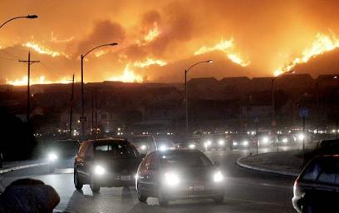
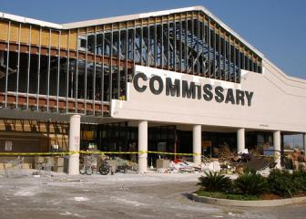
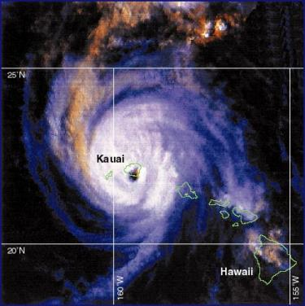
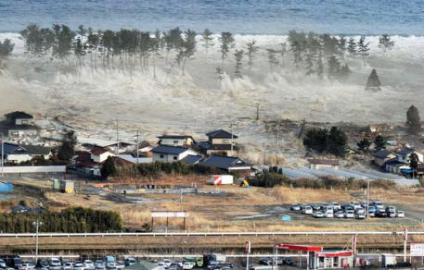
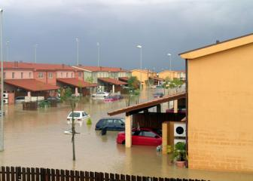
Be Informed: Emergencies Happen
Notes:
Emergencies happen every day, all around the world.
And emergencies can and do occur in Hawaii, which we call home.
Here you can see the impacts of
In the United States, losses from flooding average more than 2.4 billion dollars a year.
(in the pictures)flooding at a Navy family housing complex in Sicily.
Home fires cause thousands of deaths and injuries.
(in the pictures)CA Wildfires in 2006
Hurricane Katrina stranded 60,000 people and destroyed 300,000 homes.
(in the pictures)Hurricane Katrina on the Commissary at Gulfport, Mississippi, and
Terrorism deaths are on the rise worldwide.
Anyone recognize this wahine?
The eye of Hurricane Iniki passed directly over the island of Kauai on September 11, 1992, as a Category 4 hurricane on the Safer-Simpson Hurricane Scale.
It was the first hurricane to hit the state since Hurricane Iwa in the 1982 season, and the first major hurricane since Hurricane Dot in 1959.
Iniki caused around $1.8 billion (1992 US dollars) in damage and six deaths. At the time, Iniki was among the costliest United States hurricanes, and it remains one of the costliest hurricanes on record in the eastern Pacific. The storm struck just weeks after Hurricane Andrew—the costliest tropical cyclone ever at the time—struck the U.S. state of Florida. It was also one of two Category 4 hurricanes to strike the United States that year, as Andrew made landfall in Florida as a Category 5 just a few weeks earlier.

Slide 11
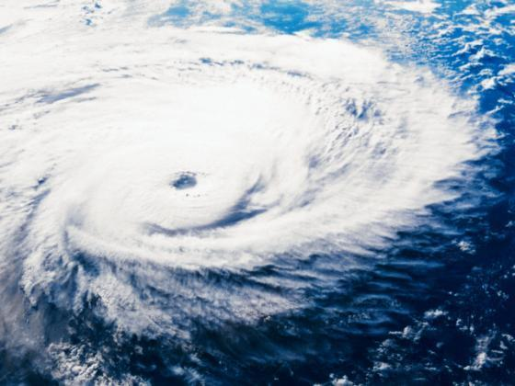
Hurricane Preparedness
Notes:
Cyclones are large-scale, tropical cyclones are medium in size, but when turned into hurricanes may get bigger.
Unlike cyclones, hurricanes can hit the shores and may wreck havoc in populated places.
Hurricanes have warm core system, wherein the eyes are warmer than its surroundings, cyclones do not have these.
Hurricane is a type of tropical cyclone that is faster and can hit the shores

Slide 12
Tropical Storms Vs. Hurricanes
Tropical Depression – A rotary circulation of clouds and winds up to 38 mph
Tropical Storm – A rotary circulation of clouds and winds between 39–73 mph
Hurricane Watch – Threat of hurricane conditions within 36 hours
Hurricane Warning – Hurricane conditions expected within 24 hours
Notes:
As you can see, this slides shows us the differences between tropical depression and hurricanes.
Tropical Depression – A rotary circulation of clouds and winds up to 38 mph
Tropical Storm – A rotary circulation of clouds and winds between 39–73 mph
Hurricane Watch – Threat of hurricane conditions within 36 hours
Hurricane Warning – Hurricane conditions expected within 24 hours

Slide 13
Hurricanes:
A Dangerous Triple Threat
High Winds
  Mountainous terrain accelerates wind speeds
  Winds increase on the back side of hurricane
  Airborne debris severe injury or death
Heavy Rains and Flash Flooding
  Tropical storms and even a weak hurricane can bring torrential rains and flash flooding
  TURN AROUND DON’T DROWN
High Waves and Storm Surge
  Greatest loss of life associated due to coastal inundation
  Large ocean swells may reach Hawaii while hurricane is several hundred miles away
Notes:
This slide describes:
High Winds
Mountainous terrain accelerates wind speeds
Winds increase on the back side of hurricane
Airborne debris severe injury or death
Heavy Rains and Flash Flooding
Tropical storms and even a weak hurricane can bring torrential rains and flash flooding
TURN AROUND DON’T DROWN
High Waves and Storm Surge
Greatest loss of life associated due to coastal inundation
Large ocean swells may reach Hawaii while hurricane is several hundred miles away

Slide 14
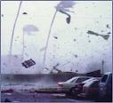
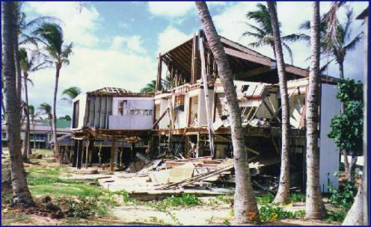
Hurricane Season
Hurricane season in Hawaii is 1 June through 30 November
Five major hurricanes have made landfall Hawaii since 1950
Hurricane Iniki was the last major hurricane on 9/11/92
Iniki caused 6 deaths and $1.8 billion in damage
Notes:
Damage would be equivalent to $2.8 billion in 2004 dollars. Photo is of a house on Kauai after Iniki. We are overdue for a hurricane in Hawaii……………..
Exercise Pitch for Volunteers
As discussed at the last HURREX Conference, we are trying to set-up a safe haven registration table at the NEX on Thursday, May 26th at 12:30pm. I was hoping you could mention this at your training sessions and request volunteers. Although Master Chief Sibal is helping to get some military volunteers, I think it would be a good idea to let the community know that they can actually take part in the registration process. If you could have a registration sheet for this event, it would help us out tremendously.

Slide 15
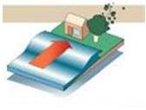
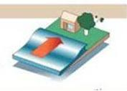
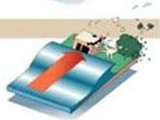
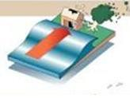
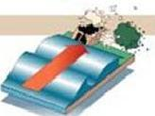
Hurricane: Saffir-Simpson ScaleCategory 1: 74-95mph 1 2
Category 2: 96-110mph
Category 3: 111-130mph 3 4
Category 4: 131-155mph
Category 5: 156+ 5
Hurricane/Tropical Storm Watch: Hurricane/Tropical Storm conditions are possible within 48 hours.
Hurricane/Tropical Storm Warning: Hurricane/Tropical Storm conditions are expected within 36 hours.
Hurricane: Saffir-Simpson Scale
Category 1: 74-95mph 1 2
Category 2: 96-110mph
Category 3: 111-130mph 3 4
Category 4: 131-155mph
Category 5: 156+ 5
Hurricane/Tropical Storm Watch: Hurricane/Tropical Storm conditions are possible within 48 hours.
Hurricane/Tropical Storm Warning: Hurricane/Tropical Storm conditions are expected within 36 hours.
Notes:
<click>
CATEGORY 1
Winds: 74 to 95 mph
Damage: Minimal; signs, unanchored mobile homes, tree branches power lines blown down, some coastal flooding. Accompanied by a 4- to 5-foot storm surge.
<click>
CATEGORY 2
Winds: 96 to 110 mph
Damage: Moderate; larger signs, roofs, doors, windows, mobile homes, small boats, some flooding, tree branches blown down. Area power outages for days. Accompanied by a storm surge of 6 to 8 feet.
<click>
CATEGORY 3
Winds: 111 to 130 mph
Damage: Extensive; minor damage to buildings, some walls fail, mobile homes, trees blown down. Flooding washes away smaller coastal structures. Flooding up to 8 miles inland. Trees down, widespread power outages for days. A storm surge of nine to 12 feet
<click>
CATEGORY 4
Winds: 131 to 155 mph
Damage: Extreme; almost total destruction of doors, windows. Some wall and roof failure. Major damage to lower floors of oceanfront buildings. Evacuations up to 6 miles inland. Power lines and poles down, power out for weeks. A storm surge of 13 to 18 feet. Hurricanes Iniki was a Category 4 storm.
<click>
CATEGORY 5
Winds: More than 155 mph
Damage: Catastrophic; buildings, roofs, structures destroyed. Flooding up to 10 miles inland, evacuation of area. Power out for weeks/months. A storm surge higher than 18 feet.

Slide 16
Post Hurricane Landfall Do's and Don’ts
DO Muster with your command/organization for yourself and your family (ADPAAS or AFPAAS).
DON’T leave a safe location or return if you evacuated, stay there until you receive the “All Clear”
DO Tune in to local radio and television stations for information about caring for your household, where to find medical help, how to apply for assistance, etc.
DON’T go near downed power lines and DO report them to the power company.
DON’T drink or prepare food with tap water until you are notified by officials that it is safe to do so.
Notes:
These are the DO’s and Don’ts for Post Hurricanes
DO Muster with your command/organization for yourself and your family (ADPAAS or AFPAAS).
DON’T leave a safe location or return if you evacuated, stay there until you receive the “All Clear”
DO Tune in to local radio and television stations for information about caring for your household, where to find medical help, how to apply for assistance, etc.
DON’T go near downed power lines and DO report them to the power company.
DON’T drink or prepare food with tap water until you are notified by officials that it is safe to do so.

Slide 17
Post Hurricane Landfall
DO Stay away from disaster areas unless authorities request volunteers.
DON’T Drive unless if it is absolutely necessary, and avoid flooded roads and washed-out bridges.
DO Check on neighbors and provide assistance and call for help if necessary.
DON’T Tie-up telephone or cell systems with unnecessary calls reserve the system for emergencies.
DO Enter your home with caution. Be aware of insects and animals driven to higher ground by the floodwaters and potential pollutants/sewage in floodwaters.
DO Talk to your children about what happened and what they can do to help.
Notes:
It continue>>>>
DO Stay away from disaster areas unless authorities request volunteers.
DON’T Drive only if it is absolutely necessary, and avoid flooded roads and washed-out bridges.
DO Check on neighbors and provide assistance and call for help if necessary.
DON’T Tie-up telephone or cell systems with unnecessary calls reserve the system for emergencies.
DO Enter your home with caution. Be aware of insects and animals driven to higher ground by the floodwaters and potential pollutants/sewage in floodwaters.
DO Talk to your children about what happened and what they can do to help.

Slide 18
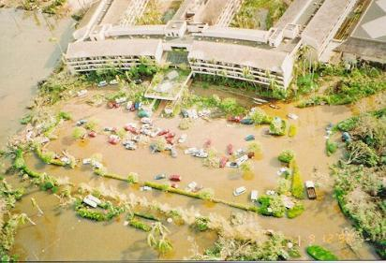
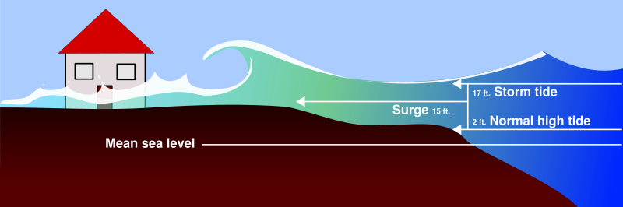
Storm Surge/Flood
Greatest potentially for loss of life
Caused by hurricane force winds
Causes severe flooding
Can increase the tide by 15 feet
Hurricane Iniki (CAT 4) had an 18’ storm surge
Penetrated 800+ feet inland past high water mark
Notes:
Photo is of the damage caused on Kauai by the storm surge of Iniki in 1992.
It’s important to know the difference between:
Flood Advisory: Flooding is likely or is occurring. Issued for less serious events.
Flash Flood Watch: Flooding is likely, people in flood zones should listen for future broadcasts. May be upgraded to a warning, extended or canceled.
Warning: It is already flooding or will flood soon.

Slide 19
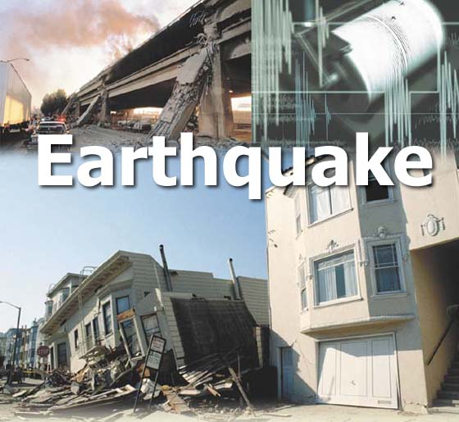
title

Slide 20
Earthquakes
Hawaii experiences thousands of earthquakes annually, most are never felt.
Earthquake is caused by release of energy at a fault line or movement of volcanic magma
Strong earthquakes endanger people by shaking/collapsing structures, causing ground cracks, ground settling landslides and Tsunamis
Size is measured on the Richter Scale
  Magnitude 3 felt by people near the source
  Magnitude 5 potentially damaging
  Magnitude 7 or greater widespread damage to people and property
Notes:
Self explanatory***
Hawaii experiences thousands of earthquakes annually, most are never felt.
Earthquake is caused by release of energy at a fault line or movement of volcanic magma
Strong earthquakes endanger people by shaking/collapsing structures, causing ground cracks, ground settling landslides and Tsunamis
Size is measured on the Richter Scale
Magnitude 3 felt by people near the source
Magnitude 5 potentially damaging
Magnitude 7 or greater widespread damage to people and property

Slide 21
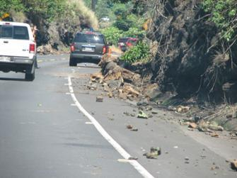
Earthquakes
PROTECT yourself during the earthquake
DROP under a sturdy table or object
COVER your head and neck
MOVE to high ground as soon as it is safe. Avoid downed power lines and weakened overpasses and if you are outside of a tsunami hazard zone, stay where you are
STAY on high ground. Return to the coast only when officials have announced that it is safe to do so
Notes:
READ:
PROTECT yourself during the earthquake.
If indoors, DROP under a sturdy table or object COVER your head and neck and HOLD ON
If outdoors, move to a clear area if you can safely do so - away from trees, beach cliffs, signs and other hazards - and drop to the ground
If you have mobility impairments that prevent you from getting up on your own, do not drop to the ground but do cover your head and neck and hold on.
When was the last time Hawaii had an earthquake?
Where were you when it happened?
Anyone remember Oct 2006? Earthquake! In Hawaii.

Slide 22
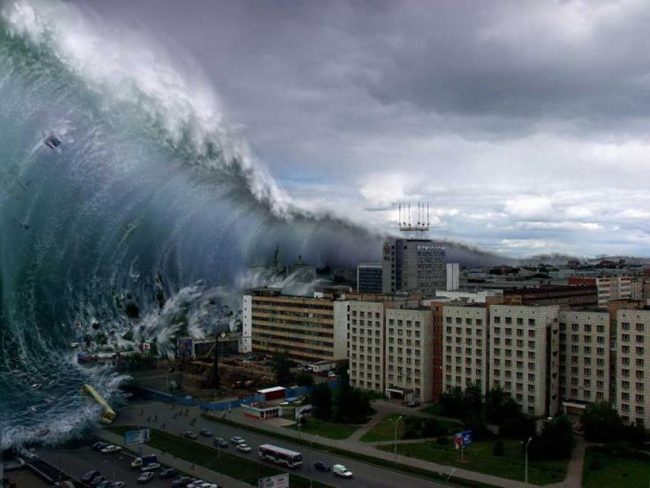
Tsunami
Notes:
Could this happen in Hawaii?
Think about you and your family….

Slide 23
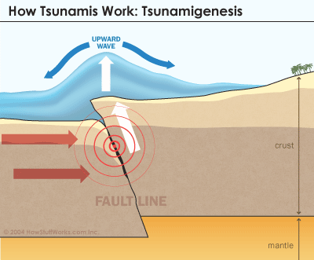
Tsunami Fact
Tsunamis are caused by earthquakes, large landslides or underwater landslides
There are two types of Tsunami; distant and local
  This translates to escape time
  For a distant tsunami, you do not need to evacuate if you are not located above the Evacuation Zone
Tsunami is not a single wave but a series of 5 – 7 waves
The first wave is usually not the largest
The most dangerous place to be is at the beach or near lagoons
Notes:
READ:
Distant tsunami caused by earthquakes thousands of miles from Hawaii. Most probable starting locations of distant tsunami for Hawaii would be Alaska, Japan, South America, and the West Coast of the USA.
Map of inundation zone is located in the phone book or at the State Civil Defense website

Slide 24
Tsunami Notifications
Tsunami Advisory
  A seismic event has occurred that could cause a tsunami
Tsunami Watch
  Based on seismic information without confirmation that a destructive tsunami is underway
Tsunami Warning
  Imminent threat of a tsunami
Notes:
READ:
Warnings are issued due to the imminent threat of a tsunami from a large undersea earthquake or following confirmation that a potentially destructive tsunami is underway
Watches are issued by the Tsunami Warning Centers based on seismic information without confirmation that a destructive tsunami is underway.
Advisories are issued to coastal populations within areas not currently in either warning or watch status when a tsunami warning has been issued for another region of the same ocean.

Slide 25
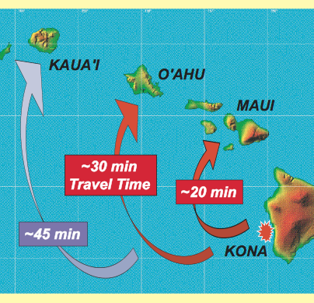

Local Tsunami Threat:
30 minutes to Waikiki, Oahu
Notes:
READ:
Hawaii’s local tsunami threat is related to the large earthquakes associated with the active volcanoes of Kilauea and Mauna Loa on the island of Hawaii. A large earthquake can generate a tsunami which would hit local areas in minutes and the densely populated Waikiki tourist area in 30 minutes.

Slide 26
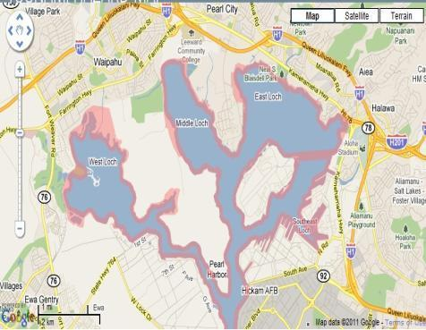
Evacuation Zones
Do you live in an Evacuation Zone?
To view Tsunami Evacuation Zone Maps
  Look in your NEW (2012)telephone book or go to: http://www.scd.hawaii.gov/
You must know before you hear the sirens whether or not you need to evacuate.
Notes:
ASK:
Do you live in an Evacuation Zone?
How would you find out?

Slide 27
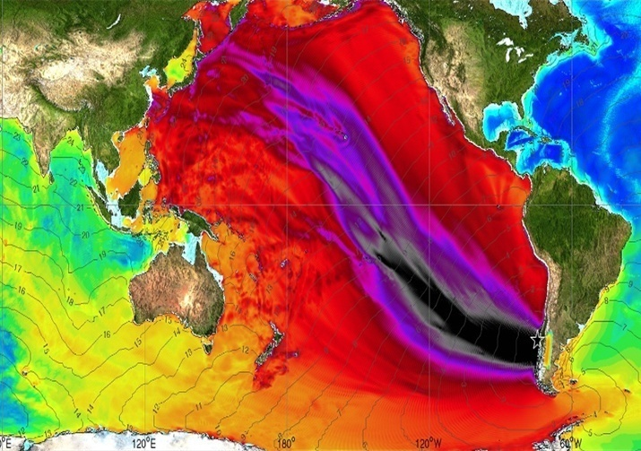
HAWAII
Amp. (cm)
>=240
220
200
180
160
140
120
100
80
60
40
20
0
Notes:
Can any one take a guess on what this slide is showing us? The Maximum Amplitude of Tsunami
** 1960 Chile tsunami (EQ magnitude Mw 9.5) Maximum amplitude plot for comparison with Feb 27, 2010 Chile tsunami event**

Slide 28
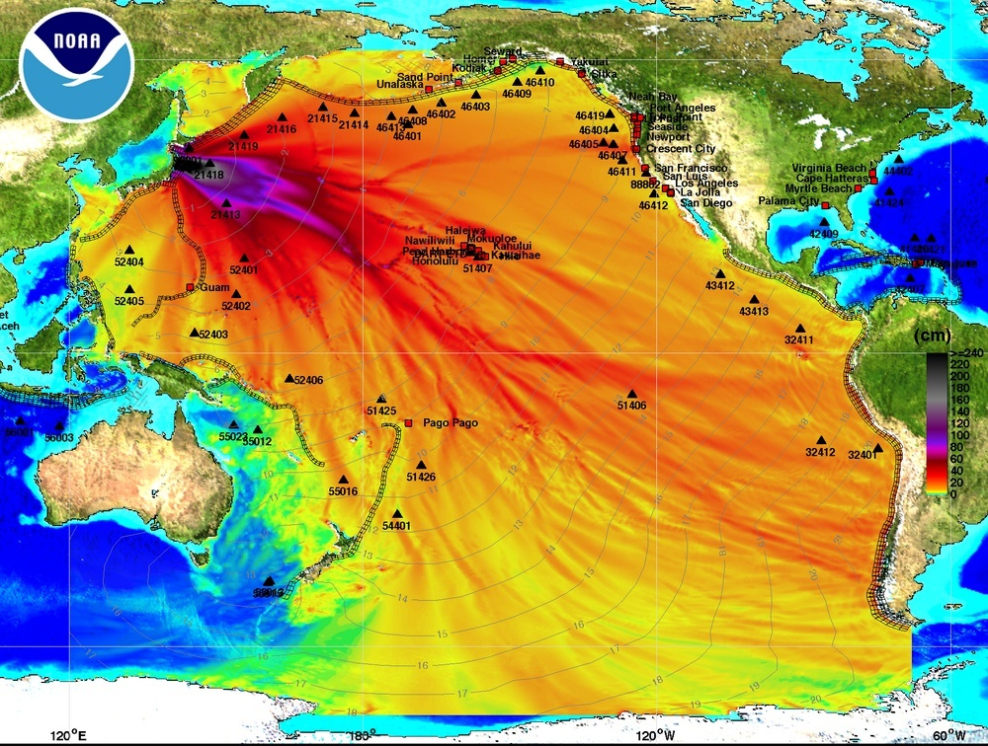
HAWAII
Notes:
Can anyone guess what this might be?
Honshu, Japan EQ/Tsunami Disaster
March 10, 2011
This happen last year! Where were you? Were you prepared if something like this happened in Hawaii? Did you and your family know what to do?

Slide 29
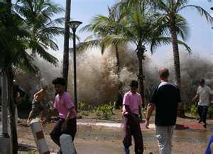
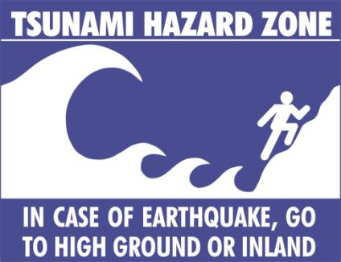
Tsunami Actions
Get to High Ground
Be Aware of where you are
Consider Vertical Evacuation in an urban area
Don't try and fight traffic
Go up 6 to 7 floors in tall buildings
Notes:
Here are some questions:
Where is your higher ground?
Where is your closest shelter?
Where do I find that information?

Slide 30
Tornados
What is a tornado?
  Violent windstorm characterized by funnel-shaped cloud
  Spawned by thunderstorms or a hurricane
Tornado Watch – issued when conditions are favorable to formation of tornadoes
Tornado Warning- tornado has been sighted
Notes:
READ:
What is a tornado?
Violent windstorm characterized by funnel-shaped cloud
Spawned by thunderstorms or a hurricane
Tornado Watch – issued when conditions are favorable to formation of tornadoes
Tornado Warning- tornado has been sighted

Slide 31
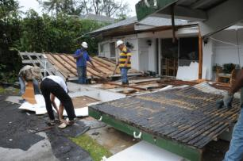
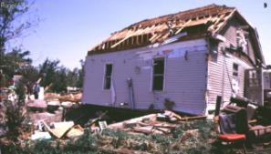

Tornados
Hawaii has experienced 4 tornados in past 3 yrs
Tornados are on Fujita Scale
  F0 Winds 40 – 72 mph - Light Damage
  F1 Winds 73 – 112 mph – Moderate damage:
  F2 Winds 113 – 157 mph – Significant Damage
Notes:
READ:
Light Damage -
F0 Winds 40 – 72 mph - Light Damage
Some damage to chimneys; branches broken off trees; shallow-rooted trees pushed over; sign boards damaged.
F1 Winds 73 – 112 mph – Moderate damage:
The lower limit is the beginning of hurricane wind speed; peels surface off roofs; mobile homes pushed off foundations or overturned; moving autos pushed off the roads; attached garages may be destroyed.
F2 Winds 113 – 157 mph –
Significant damage Roofs torn off frame houses; mobile homes demolished; boxcars overturned; large trees snapped or uprooted; high-rise windows broken and blown in; light-object missiles generated.

Slide 32

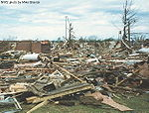

Tornados
F3 Winds 158- 206 mph Severe Damage
F4 Winds 204 – 260 mph Devastating Damage
F5 Winds 261- 318+ mph Incredible damage
Notes:
F3 Winds 158- 206 mph Sever Damage
Roofs and some walls torn off well-constructed houses; most trees in forest uprooted; skyscrapers twisted and deformed with massive destruction of exteriors; heavy cars lifted off the ground and thrown
F4 Winds 204 – 260 mph Devastating Damage
Well-constructed houses leveled; structures with weak foundations blown away some distance; trains overturned; cars thrown and large missiles generated. Skyscrapers and highrises toppled and destroyed
F5 Winds 261- 318+ mph Incredible damage
Strong frame houses lifted off foundations and carried considerable distances to disintegrate; automobile sized missiles fly through the air in excess of 100 m (109 yd); trees debarked; steel reinforced concrete structures badly damaged.

Slide 33
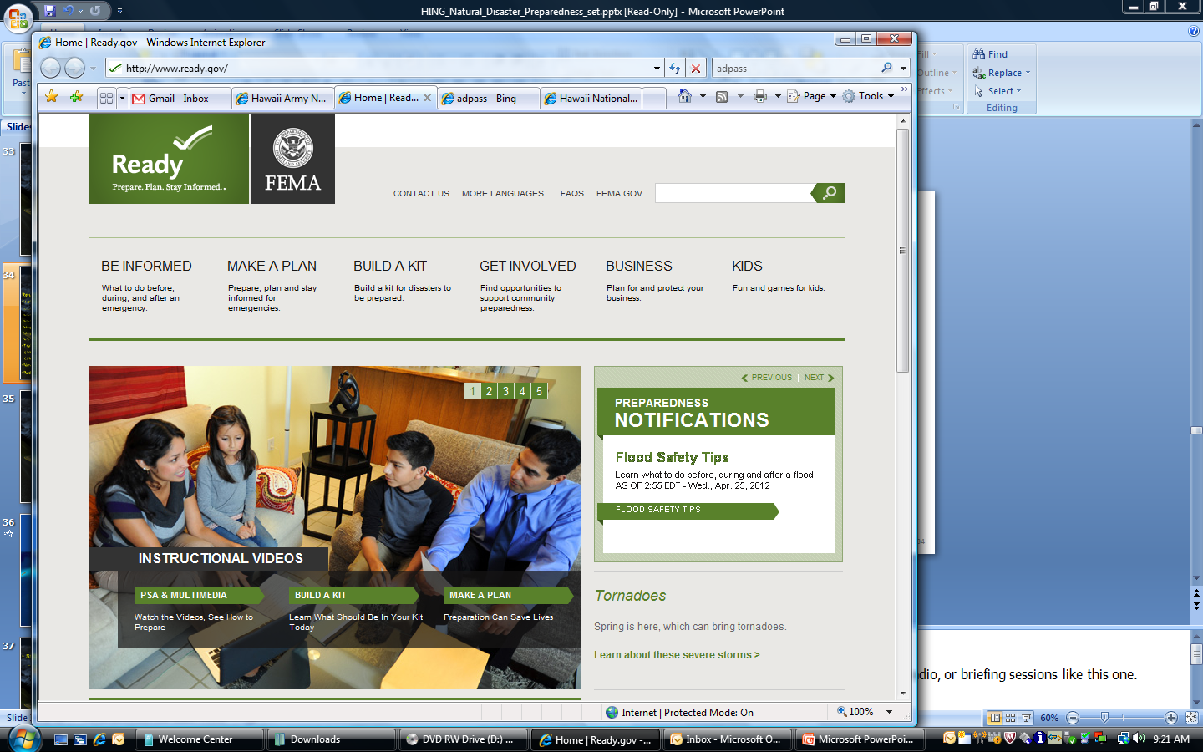
Be Informed
Resources are available
  Web sites (download plans and info)
    www.ready.gov
    www.scd.hawaii.gov
    www.hawaiiguardohana.org
    https://hi.ng.mil
    https://afpaas.af.mil
    www.acsim.army.mil
  Training courses
    CPR/First Aid
    CERT Course
  News articles
  Radio Stations; Emergency Alert Systems
Notes:
Emergency planning is up to you, but you do have resources available that can help you prepare.
You can find general and regional disaster information through a number of sources, including the Internet, television, radio, or briefing sessions like this one.
(pause)
Recommend these resources….
Take CPR courses with the state civil defense and the American red cross
***fill on our own text****

Slide 34
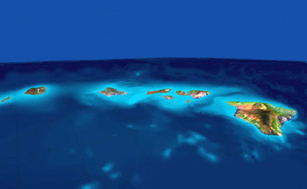

Emergency Alert System
KSSK
KRTR
CABLE
CD
KQNG
CD
KMVI
CD
KKBG
CD
Notes:
When emergencies and disasters of all types occur, rapid and effective communication of instructions and essential information to the public can significantly help reduce loss of life and property. The EAS took effect on January 1, 1997, requiring all participants to use a common protocol to originate, receive or relay emergency alerts. Hawaii’s EAS is part of the national network that enables the President of the United States to address the American people during periods of national emergency. State and local EAS plans allow State and county officials, including the National Weather Service Pacific Region, to control the use of the EAS when not in use by the President.
The EAS network is comprised of AM, FM, and TV broadcast stations; cable TV providers; participating common carriers; and other non-government entities.
When is this monthly test (steady 3 minute siren tone, attention alert signal) conducted? At 11:45 a.m. on the first state work day of each month. Tune your radio or television to any station and listen for emergency information and instructions.
Disaster Preparedness Information is also found in the white pages of the telephone books. (Includes tsunami evacuation maps.)

Slide 35

Be Informed:
State of Hawaii Shelters
State and City & County of Honolulu Shelters
  Locations of all state shelters can be found at http://www.scd.state.hi.us/
    All Schools in State of HI are Shelters
    NOTE: Not all schools will be open!
    Specific shelters are set up for special needs populations and to receive pets
    Pets must have supplies and be in hard sided kennel
  Monitor the State CD website and radio/TV for opening times/locations of local shelter as not all schools will open as shelters
  Ensure you bring your Emergency Kit and water with you
Notes:
BE INFORMED:
State and City & County of Honolulu Shelters
Locations of all state shelters can be found at http://www.scd.state.hi.us/
All Schools in State of HI are Shelters
NOTE: Not all schools will be open!
Specific shelters are set up for special needs populations and to receive pets
Pets must have supplies and be in hard sided kennel
Monitor the State CD website and radio/TV for opening times/locations of local shelter as not all schools will open as shelters
Ensure you bring your Emergency Kit and water with you

Slide 36
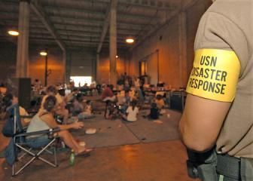
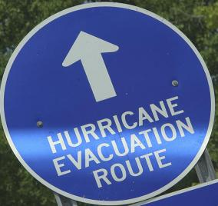
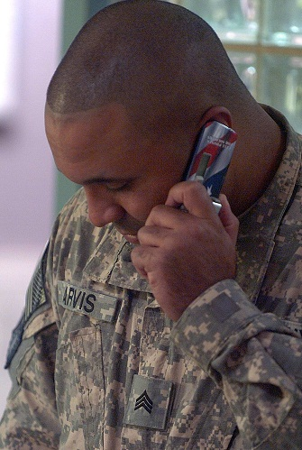
Have a Plan
Family Emergency Plan
Family Communication Plan
Notes:
HAVE A PLAN:
One of the most important tools you and you family can have to protect yourself in possible emergencies is a family preparedness plan. It is important that you plan ahead as a family for all types of emergencies and responses.
Everyone in the family should understand what to do, where to go, and what to take in the event of an emergency.
A family emergency plan covers shelter and evacuation options.
A family communication plan helps you get in touch if you are separated.
DON’T COUNT ON YOUR CELL PHONE!!!!!

Slide 37
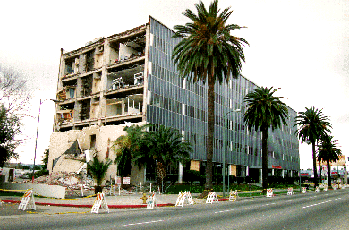
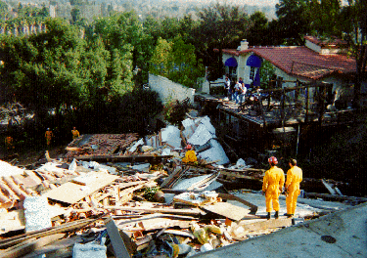
Have a plan: Family Readiness
Create a family Emergency Plan
Set up a safe spot in your home, an interior bathroom or under stairs storage area to SIP
Rally Points - where will your family reunite if separated
Keep a list of emergency phone numbers
Know your child's school plan
Develop an Emergency Kit for work, car, and home
First Aid/CPR classes
Notes:
Create an Emergency Plan with your family.
Know the safe areas in each room in the house (under sturdy tables, desks, or against inside walls).
Know where the danger areas are as well (windows, mirrors, hanging objects, fireplaces, and tall furniture).
The bed in each bedroom should be a safe zone where you or a family member could ride out an earthquake in relative safety. Avoid placement of beds against windows, under heavy objects, under heavy mirrors or framed pictures, or next to heavy bookshelves that could fall on the bed area).
Have a pre-arranged area where the family will meet if separated.
Maintain a list of emergency phone numbers, but use the phone only if absolutely necessary.
Keep a survival kit at home, in your car, and at work, in case stores and other services are not available for a few days.
Keep a pair of shoes available, and if possible, put them on before trying to leave the house. Glass, splinters, nails, and other debris can inflict serious injuries.
Contact you insurance company for any questions pertaining homeowner and rental insurance. As the Government, we cannot answer insurance questions.

Slide 38
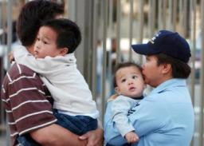
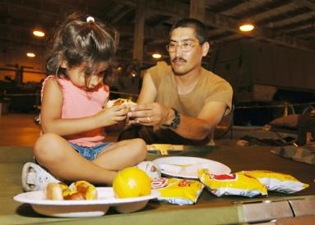
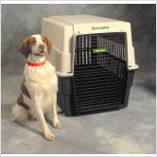
Have a Plan: Discuss your options
Temporarily shelter-in-place
Evacuate to local shelter
  -Don’t wait for the last minute!!!!!
Move to a safe haven if directed
Notes:
In some cases, such as a hazardous material emergency, you might decide (or be directed) to “shelter in place”, staying where you are in your home, your office, your school, or even your car. Shelter-in place may involve sealing openings around windows and doors or just staying inside.
Safe and effective evacuation requires planning ahead—there may be little advance warning. In the event of an evacuation, you may end up at a civilian shelter or an on-base safe haven.
Be sure to consider children, pets, and special needs adults when putting together your emergency plan. Adjust your plan to accommodate all of your family members’ needs.

Slide 39
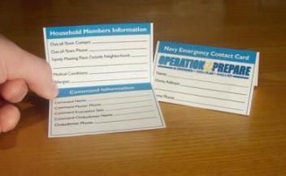
Have a Communications Plan:
Keep in Touch
Know contact information
Make emergency contact cards
Designate an out of state relative as a family focal point so you only have to make ONE call.
Remember text messages may go through when cell calls will not
VOIP fails without electricity or cable service
Conduct a dry run
Notes:
Your family may not be together when a disaster strikes, so plan how to contact one another. Prepare a family communication plan that includes information on where family members spend the most time, such as work or school.
Make emergency contact cards for everyone in the family. Include important personal information, out of town contacts, and medical conditions, as well as your Command Information.
After discussing your options, conduct a dry run of your evacuation plan. Try to identify any problems or obstacles so you can fix them before a real emergency occurs.

Slide 40
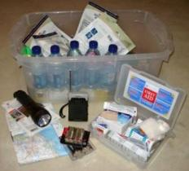
Make a Kit
Recommended supplies for basic emergency kit:
Water- 1 GAL/person/day for at least 7 days
Nonperishable food for at least 7 days
Manual can opener
First aid kit
Prescription medications
Dust masks
Personal sanitation supplies such as moist towelettes, garbage bags, and plastic ties
Flashlight & extra batteries
Battery powered or hand crank radio with NOAA Weather channel
Money - $250 cash (small bills)
Wrench or pliers to turn off utilities
Local maps and your evacuation plan
Family communications plan
Other plans and any important documents
Kits for work and car
Pet supplies
Notes:
Water- 1 GAL/person/day for at least 7 days
Nonperishable food for at least 7 days
Manual can opener
First aid kit
Prescription medications
Dust masks
Personal sanitation supplies such as moist towelettes, garbage bags, and plastic ties
Flashlight & extra batteries
Battery powered or hand crank radio with NOAA Weather channel
Money - $250 cash ( there will be not ATM’s)
Wrench or pliers to turn off utilities
Local maps and your evacuation plan
Family communications plan
Other plans and any important documents
Kits for work and car
Pet supplies
Optional: Contact your Insurance company to make sure you know who to contact and are you covered.

Slide 41
Pre Made Kits
The following companies make pre-stocked and prepared Emergency Kits
  http://www.quakekare.com
  http://www.readysetgokits.com/
  http://www.redcrossstore.org/Shopper/Product.aspx?uniqueitemid=3
  http://www.survivalkitsonline.com/c/Survival_Kits.html
Notes:
Here are some websites that have emergency kits available. These are just resources and recommendations only

Slide 42

Notes:
Please watch this video by are you ready.gov

Slide 43
If Disaster Strikes
If you are instructed to take shelter immediately, do so at once.
If you are instructed to evacuate:
Listen to the radio or television for the location of emergency shelters and for other instructions from local emergency officials.
Wear protective clothing and sturdy shoes.
Take your disaster supplies kit.
Use travel routes specified by local authorities and don't use shortcuts because certain areas may be impassable or dangerous
Notes:
you are instructed to take shelter immediately, do so at once.
If you are instructed to evacuate:
Listen to the radio or television for the location of emergency shelters and for other instructions from local emergency officials.
Wear protective clothing and sturdy shoes.
Take your disaster supplies kit.
Use travel routes specified by local authorities and don't use shortcuts because certain areas may be impassable or dangerous

Slide 44
Contact Information
Department of Civil Defense Division, State of Hawaii
3949 Diamond Head Road
Honolulu, HI 96816
(808) 733-4301
City and County of Honolulu Department of Emergency Management
650 South King Street
Honolulu, HI 96813
(808) 723-8960
Kauai County Civil Defense Agency
Suite 100, 3990 Kaana Street
Lihue, Hawaii, 96766
(808) 241-1800
Maui County Civil Defense Agency
200 South High Street
Wailuku, HI 96793-2155
(808) 270-7285
Hawaii County Civil Defense Agency
920 Ululani St.
Hilo, HI 96720
(808) 935-0031, (808) 935-3311 (after hours)
Notes:
Department of Civil Defense Division, State of Hawaii
3949 Diamond Head Road
Honolulu, HI 96816
(808) 733-4301
City and County of Honolulu Department of Emergency Management
650 South King Street
Honolulu, HI 96813
(808) 723-8960
Kauai County Civil Defense Agency
Suite 100, 3990 Kaana Street
Lihue, Hawaii, 96766
(808) 241-1800

Slide 45
Check on Learning
What are the three ways to prepare for a natural disaster?
Be Informed. Have a Plan. Make a Kit
How long do we recommend that your disaster kit last for a minimum for each person?
7 days
What resources can be used to prepare for natural disasters?
Notes:
We got many different answers for “What resources can be used” and it is open for different answers. If you recall on the clip with our Lt. Gov, he mentioned the Hawaii Red Cross Website and his website.
<The next slide will present the additional resources>

Slide 46
Other Resources
Hawaii Red Cross
http://hawaiiredcross.org
Hawaii Disaster Preparedness http://www.getreadyhawaii.org
Hawaii State Civil Defense:
      http://scd.hawaii.gov
Ready.gov
http://www.ready.gov
State of Hawaii Lt. Gov.
http://hawaii.gov/ltgov
Notes:
Here are some the resources….

Slide 47
BE READY!!
Questions!
Notes:
Questions??
If I do not have the answer I will get it to you!

Slide 48
Commander Requirements
Account for everyone who received the training
Have them sign in!
Update into your respective branch’s training system
Natural Disaster preparedness is a required annual training (April is disaster preparedness month)

